Slide 2

Remote Dictionary Server
NAME: SHIVAM NARENDRA VIKHAR
Batch 30

Slide 3

History
What is Redis
Why Redis and Feature
How Redis works
Architecture
Architecture notes
Redis in the AI/LLM Era
Infra Diagram
Data Types
Pros/Cons
Use Cases of Redis
Tools/Alternatives + Memcached Comparison
Redis vs other DBS: Performance Benchmarks
Installation & Setup
Persistence in Redis
Security in Redis
Tools, Plugins & Ecosystem
Dependencies of Redis
Redis Worst Practices (with Fixed)
Companies that uses Redis
Conclusion + Roadmap
Resources
Quote

Slide 4
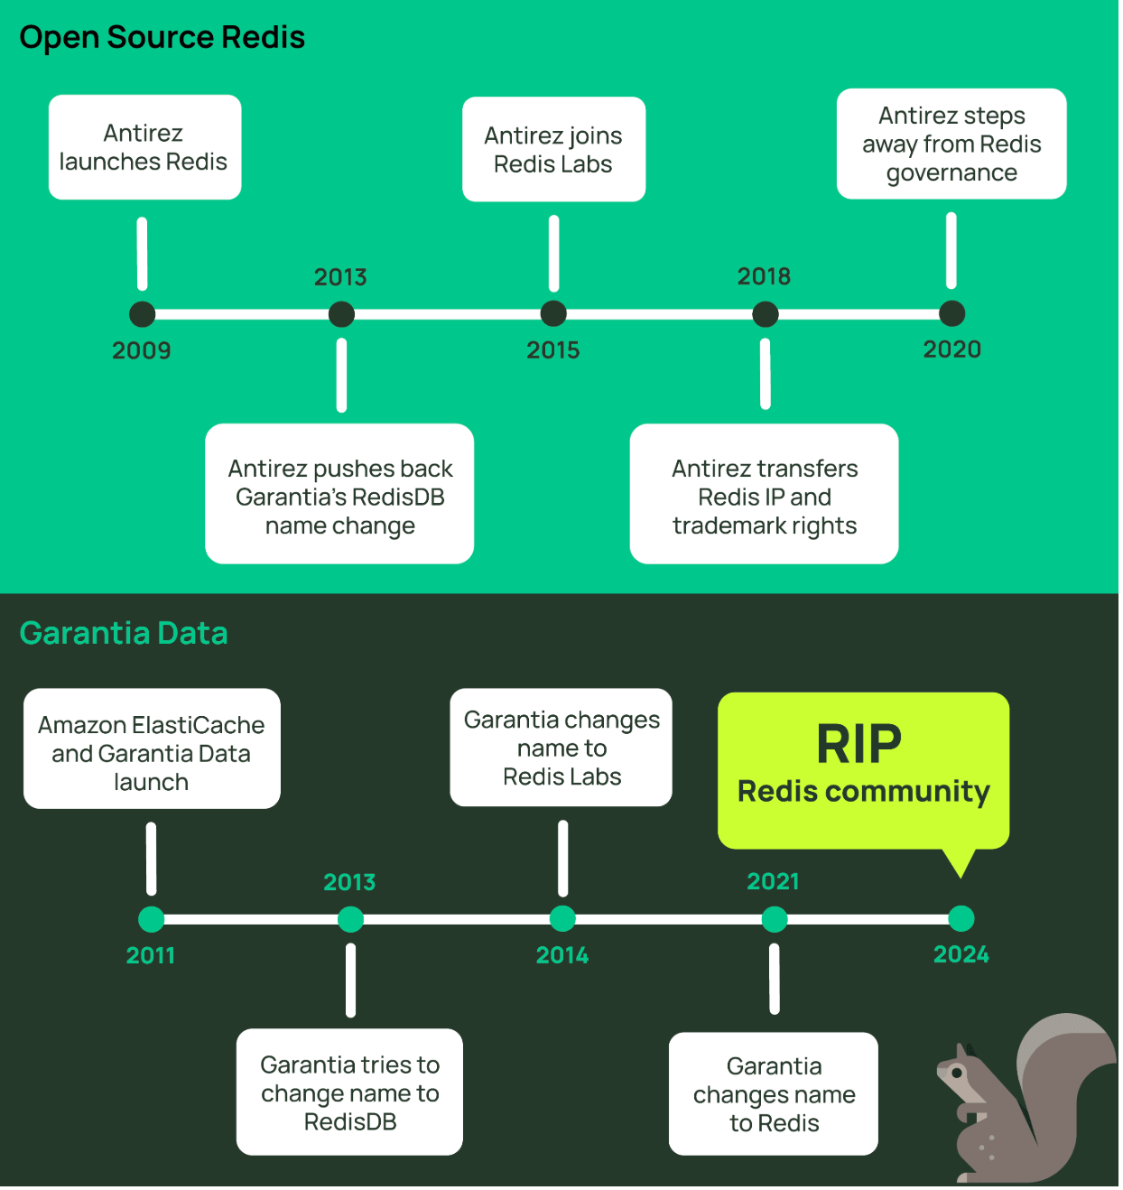
📖 History
Created by Salvatore Sanfilippo in 2009
Originally developed to improve the scalability of a real-time web analytics system
Sponsored and maintained by Redis Inc. (formerly RedisLabs)
Over the years, added features like clustering, modules, and new data types

Slide 5


Redis (REmote DIctionary Server) is an open-source, in-memory data structure store used as a database, cache, message broker, and streaming engine. It supports various data structures like strings, lists, sets, hashes, and more. Redis is known for its speed, simplicity, and support for complex data types.

Slide 6
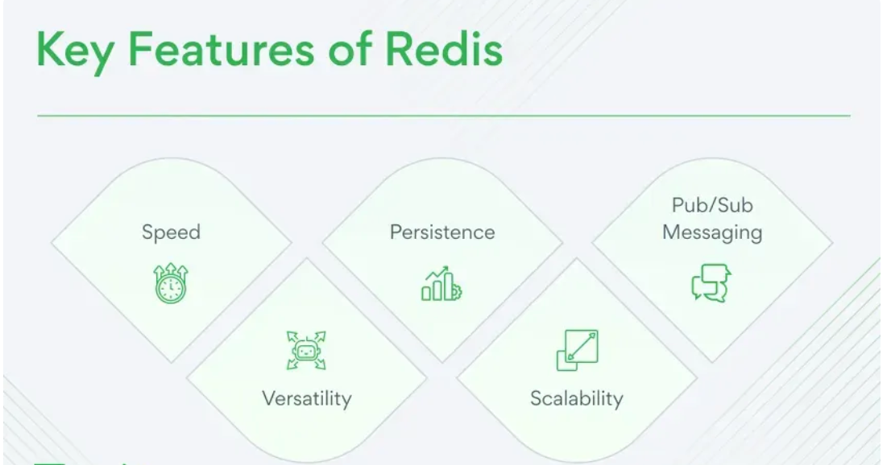
❓ Why Redis and features
Fast: All data is in RAM
Versatile: Supports many data types
Reliable: Has data persistence options
Lightweight: Simple and quick to set up
Scalable: Can grow with your application
Use Redis when speed is a top priority, such as caching search results or handling user sessions.

Slide 7
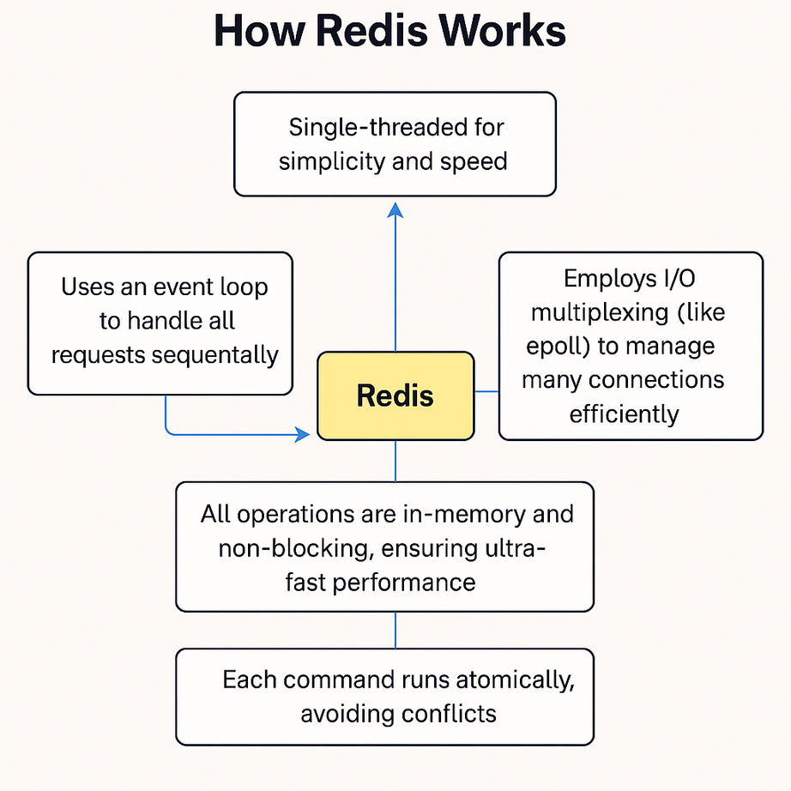
🧠 How Redis Works
Single-threaded for simplicity and speed.
Uses an event loop to handle all requests sequentially.
Utilises I/O multiplexing (similar to epoll) to efficiently manage multiple connections.
All operations are in-memory and non-blocking, ensuring ultra-fast performance.
Each command runs atomically, avoiding conflicts.

Slide 8
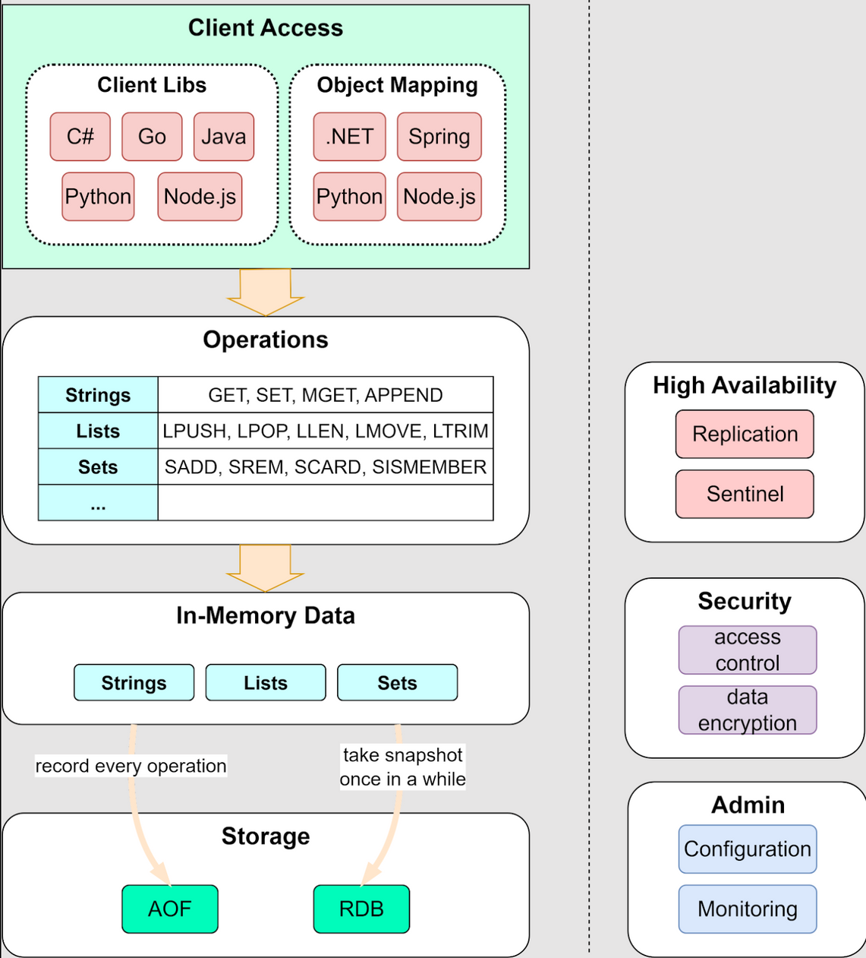
📊 Architecture
Client Access: Supports many languages like Python, Java, and Node.js.
Operations: Fast commands on Strings, Lists, Sets, etc.
In-Memory: Stores data in RAM for speed.
Storage:
AOF logs every change.
RDB takes snapshots.
High Availability: Uses Replication and Sentinel.
Security: Access control and encryption.
Admin: Configuration and monitoring tools.

Slide 9



Client-Server model
🖥️ Client-Server Model: Clients send commands (e.g., GET, SET), Redis processes them instantly.
⚙️ Single-threaded, but highly optimized for speed.
Redis is single-threaded by design, but its operations are highly optimized to be extremely fast, even under high load.
📊
High availability and scalability
🧬 Replication: Master-slave read replicas.
🛡️ Sentinel: Monitoring + automatic failover.
🌐 Cluster: Data sharding across nodes for horizontal scaling.
This architecture makes Redis reliable, efficient, and ready for enterprise-level workloads.

Slide 10
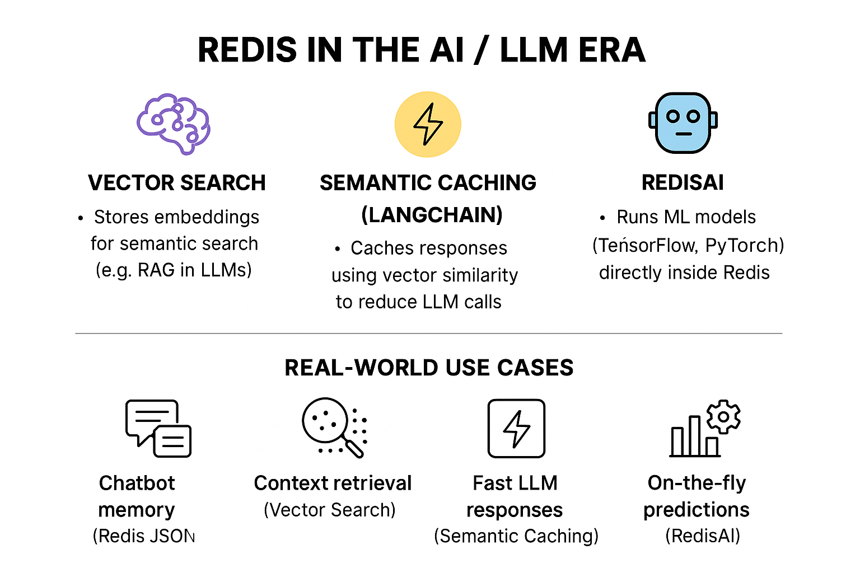
Redis in the AI / LLM Era

Slide 11
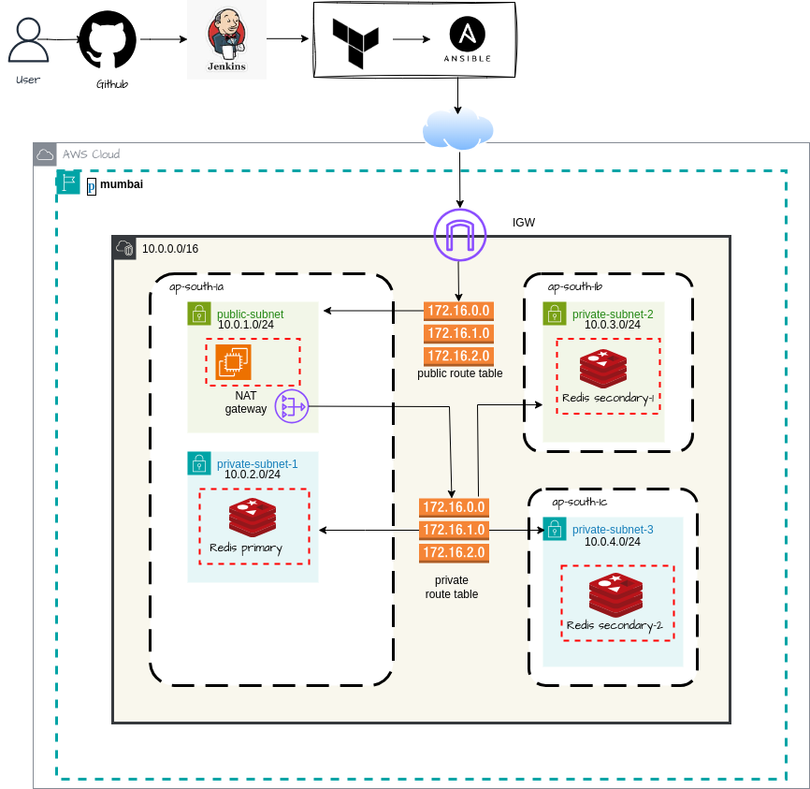
📈 Infra Diagram

Slide 12
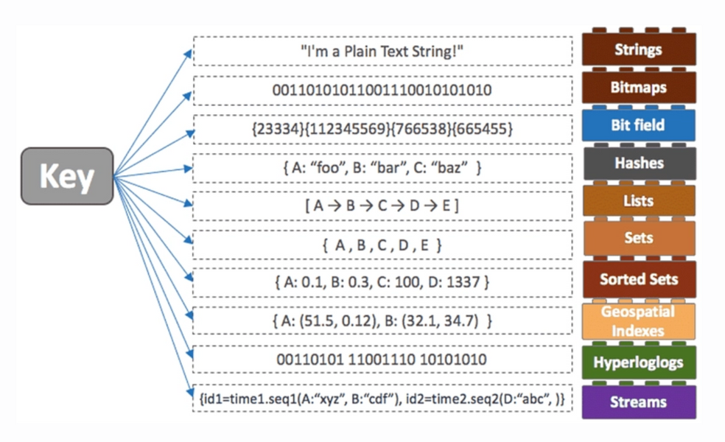
🧱 Data Types
String – Simple text or number
SET name "Shivam"
List – Ordered collection of items (like a queue)
LPUSH tasks "task1"
Set – Unordered collection of unique values
(like tags)
SADD tags "redis"
Sorted Set – Set with scores for sorting
(like a leaderboard)
ZADD leaderboard 100 "Alice"
Hash – Key-value pairs, similar to a small
JSON object
HSET user:1 name "Shivam" age "25"

Slide 13

PROS
✅
PROS
⚡ Ultra-fast performance due to in-memory storage
🧠 Simple and easy to use with straightforward commands
📈 Highly scalable with support for clustering and replication
🔧 Rich set of data types for diverse use cases
❌
CONS
💾 Limited by available RAM – may not be suitable for very large datasets
🔌 Risk of data loss if persistence is not properly configured
🧵 Single-threaded core – can limit full CPU utilization in some scenarios
CONS

Slide 14

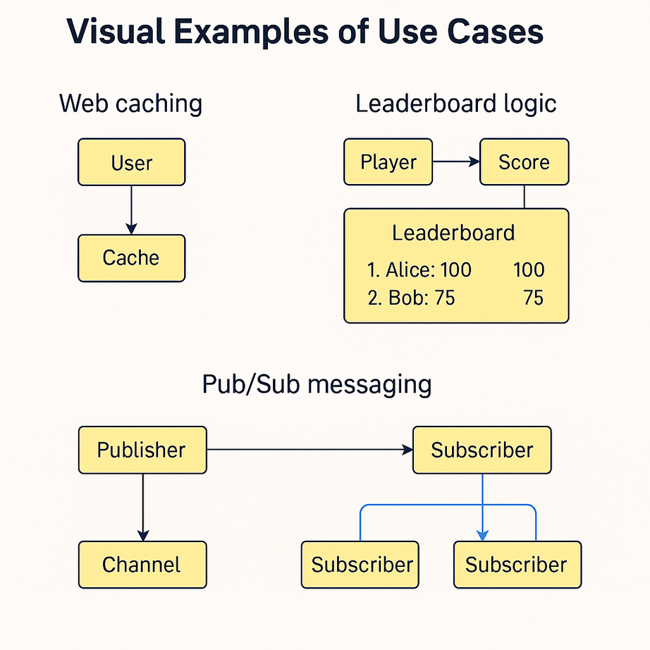
💼 Use Cases of Redis
🌐 Web Caching – Cache database queries or API responses to speed up website performance
🔐 Session Store – Manage user sessions efficiently in web applications
📊 Real-Time Analytics – Instantly count page views, clicks, or events
📬 Message Queues – Use Lists or Streams to build reliable task queues
🏆 Leaderboards – Track top users or scores using Sorted Sets
📢 Pub/Sub Systems – Enable real-time messaging for chat apps, notifications, etc.
🚫 Rate Limiting – Control API usage or prevent abuse using counters and TTLs

Slide 15
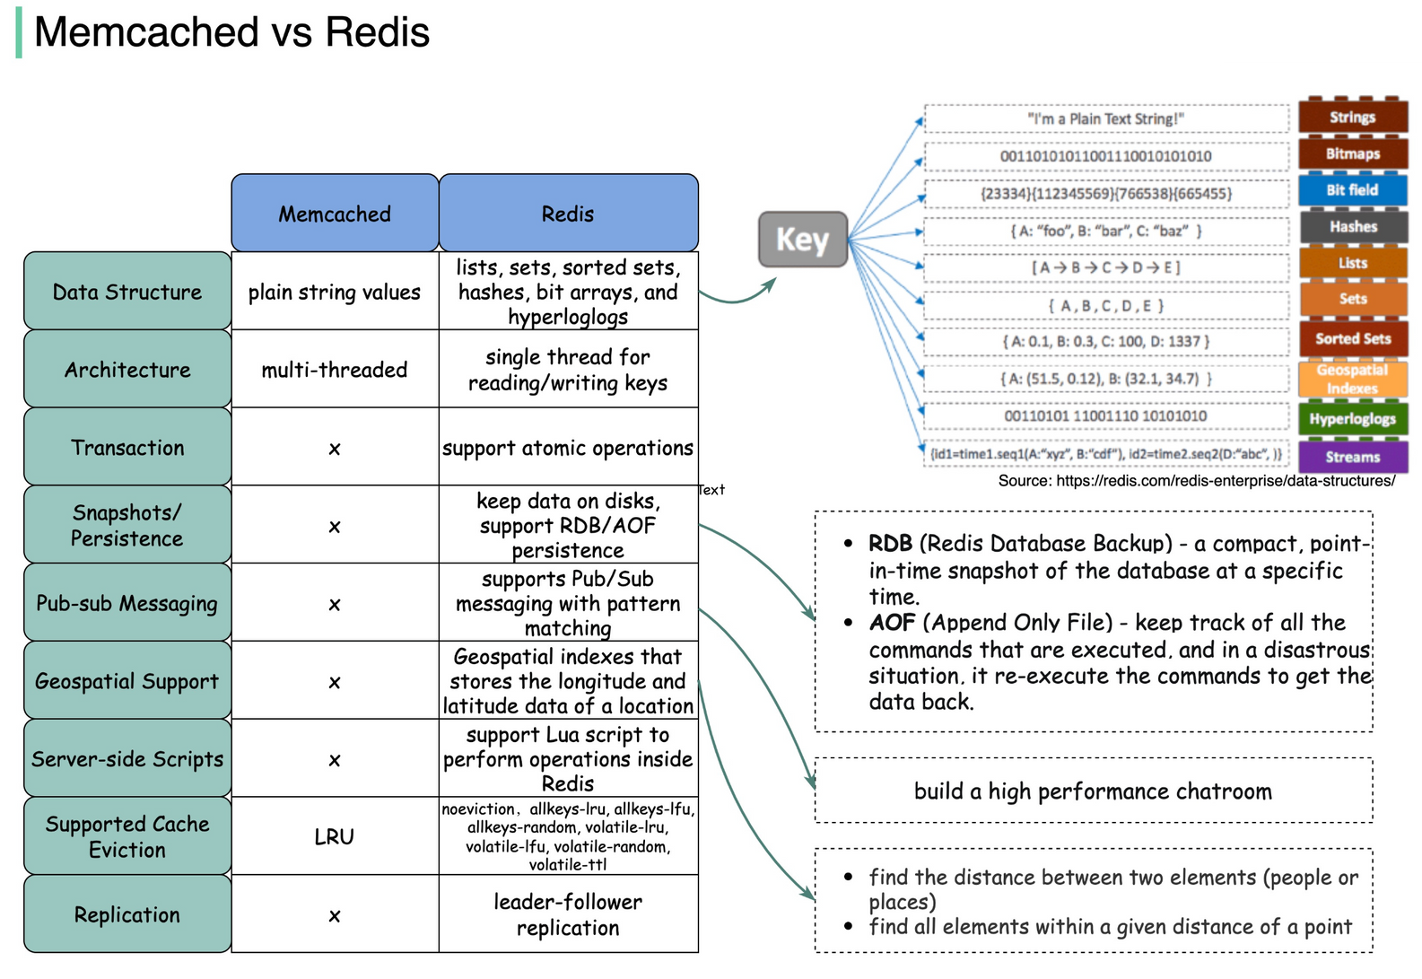
Tools & Alternatives
Alternatives to Redis
Memcached –
Extremely fast, but supports only strings and lacks persistence
2. MongoDB / Cassandra –
Better suited for document-based or columnar storage needs
3. Etcd / Consul –
Ideal for service discovery and distributed system coordination

Slide 16
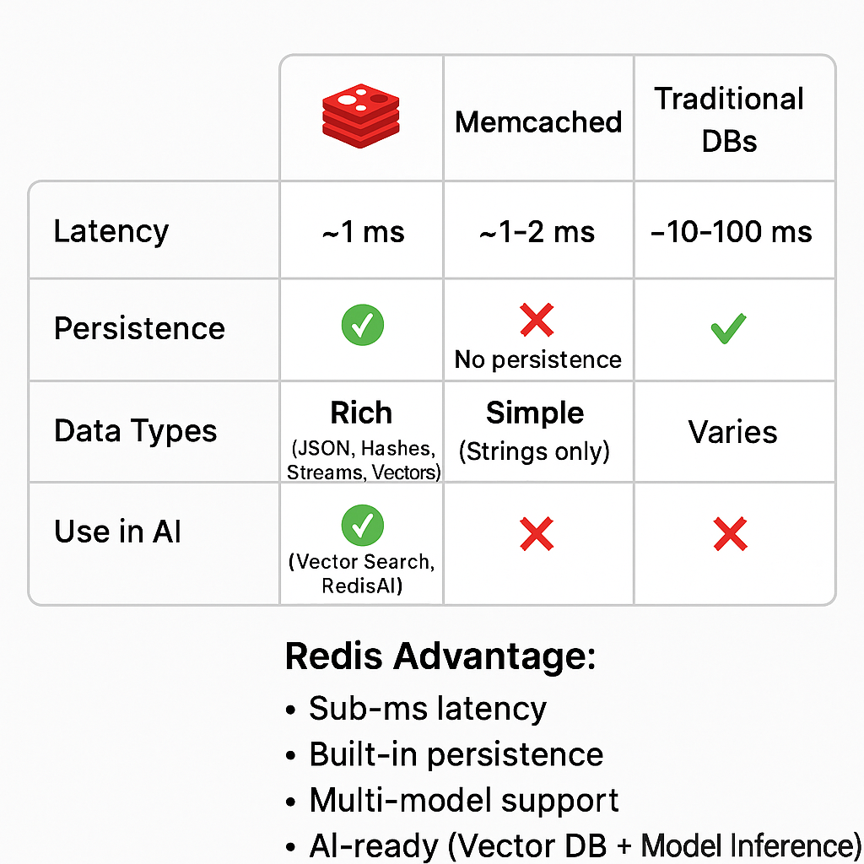
Redis vs. Other DBs: Performance Benchmarks

Slide 17
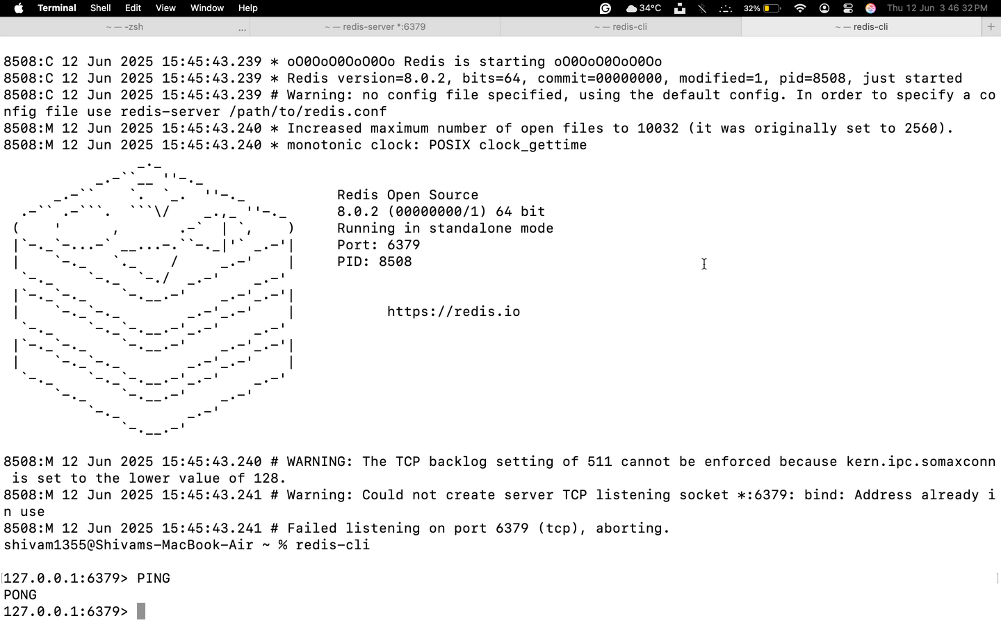
⚙️ Installation & Setup
⚙️ Installation & Setup (macOS Terminal)
🔽 1. Download Redis
Go to the official Redis website:
https://redis.io/download
Download the source file (e.g., redis-7.0.0.tar.gz).
📦 2. Extract and Compile
Open Terminal and run:
tar xzf redis-7.0.0.tar.gz
cd redis-7.0.0
make
✅ This compiles Redis and builds the binaries.
🚀 3. Start Redis Server
src/redis-server
🟢 Redis server is now running.
💬 4. Use Redis CLI (Client)
In a new terminal tab or window, run:
src/redis-cli
You can now start using Redis commands,
For example:
SET name "Shivam"
GET name
Let me know if you'd like the Homebrew
method or how to set up Redis as a background service.

Slide 18
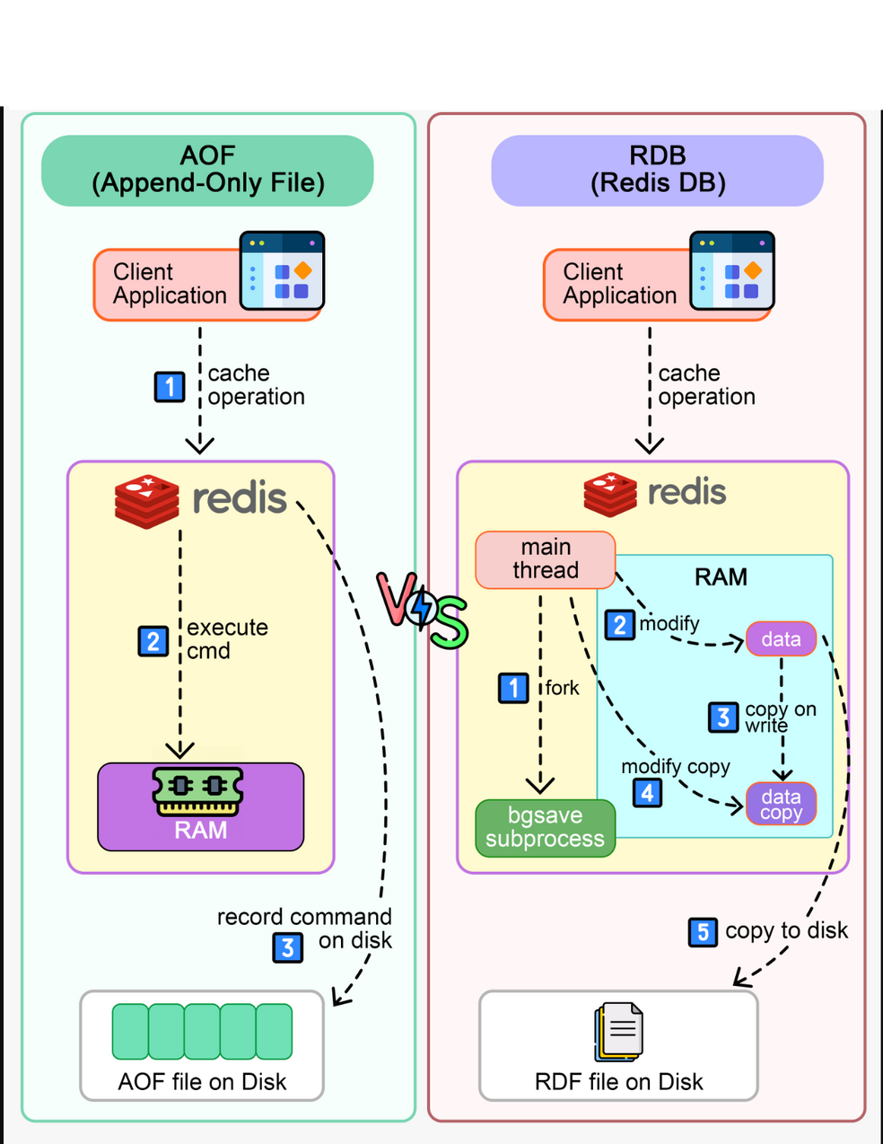
🗄️ Persistence in Redis
🧊 RDB (Snapshotting)
Saves the dataset to disk at configurable intervals.
✅ Fast to load, good for backups
⚠️ Risk of data loss if Redis crashes between snapshots
📝 AOF (Append-Only File)
Logs every write operation. On restart, Redis replays the log.
✅ More durable than RDB
⚠️ Slower to load and larger file size
🔀 Hybrid Approach
Use both RDB and AOF together for a balance of speed and reliability

Slide 19
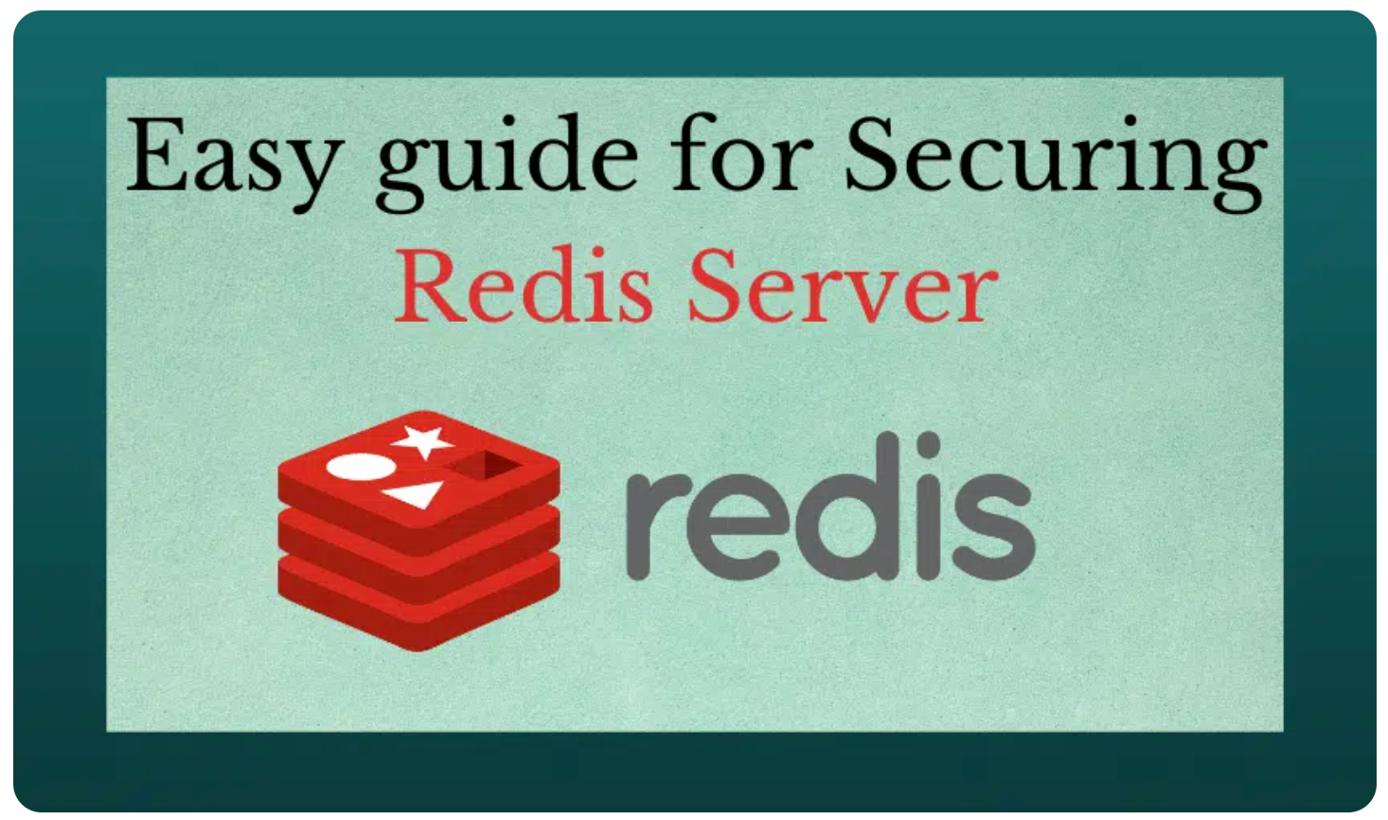
🔐 Security in Redis
Password:
Set using requirepass in redis.conf.
Network:
Bind to 127.0.0.1 or use firewalls/VPNs.
TLS:
Encrypt data in transit (especially in the cloud).
ACLs:
Control user access, commands, and key patterns.
🔸 Redis isn’t secure by default — always configure security in production.

Slide 20
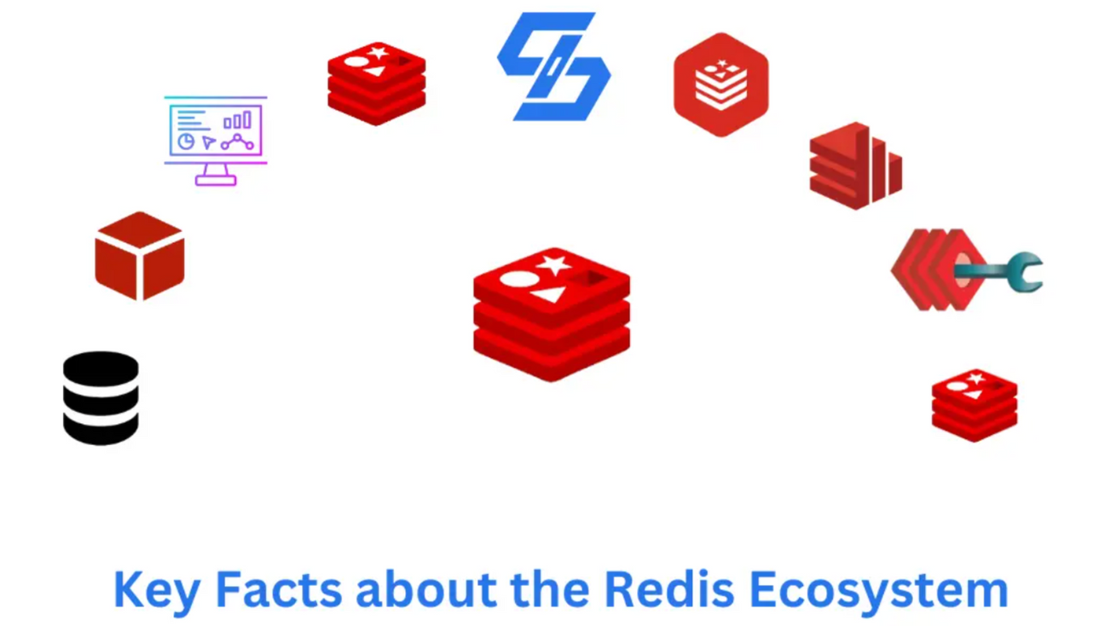
Tools, Plugins & Ecosystem
RedisInsight: A GUI tool for managing and visualizing Redis data.
Client Libraries: Language-specific tools to interact with Redis, like:
redis-py (Python)
Jedis (Java)
Lettuce (Java)
Modules: Extend Redis capabilities:
RediSearch: Full-text search
RedisGraph: Graph database
RedisJSON: Store & query JSON
RedisBloom: Probabilistic data structures (like Bloom Filters)

Slide 21
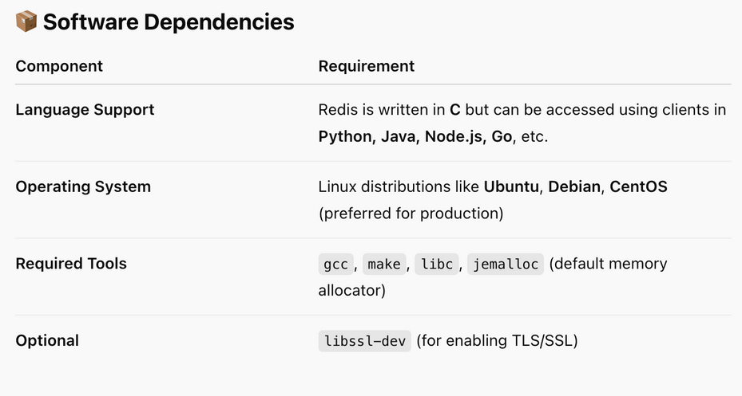
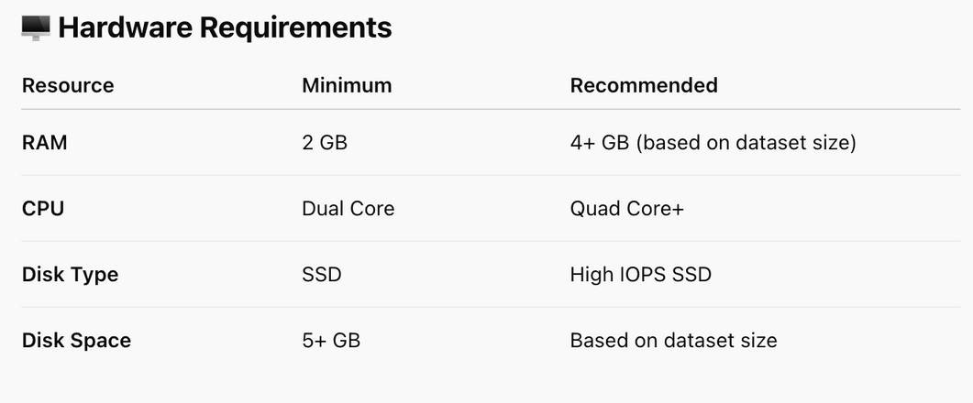
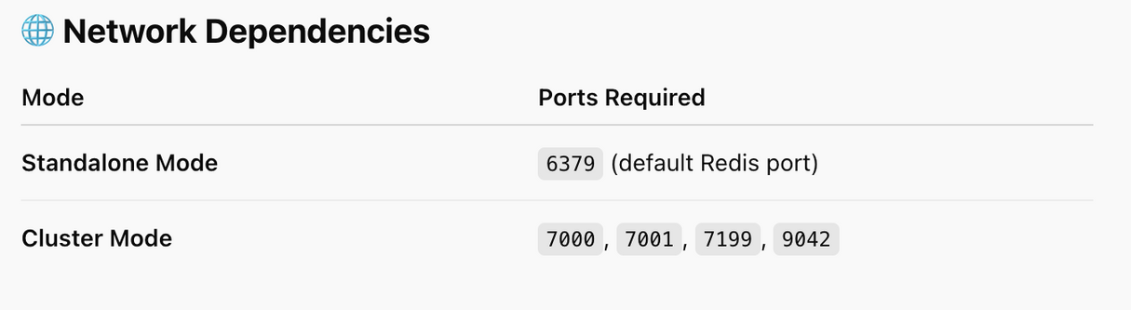
Redis Dependencies 🔧
Redis has minimal but important system and software requirements for stable and high-performance operation.
🔐 Note: 💡 Redis stores all data in memory, so RAM is the most critical resource. Plan based on your dataset and use case.
🔐 Note: Ensure these ports are open in your firewall
and VPC security groups.

Slide 22
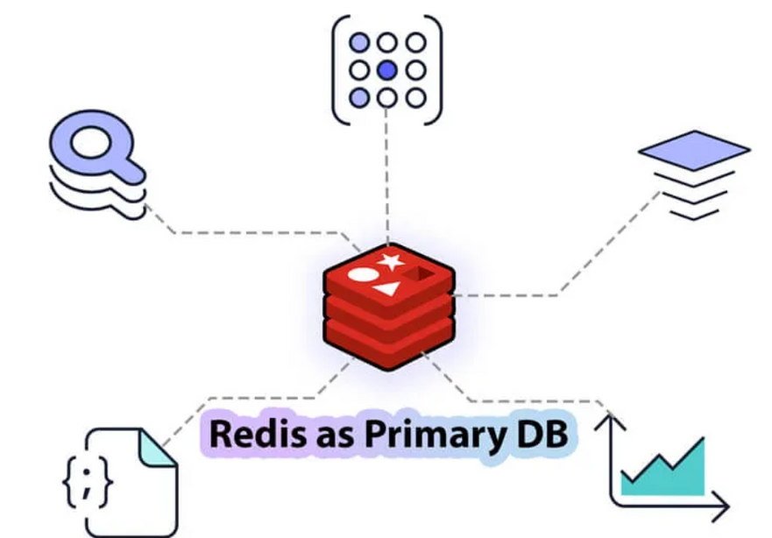
🚫 Redis Worst Practices (With Fixes)
No Password
❌ Open to attacks
✅ Use requirepass + AUTH
2. Using KEYS in Production
❌ Blocks Redis (O(n))
✅ Use SCAN
3. Numbered Databases (SELECT)
❌ Not truly isolated, no cluster support
✅ Use separate Redis instances
4. Unbounded Commands (HGETALL, LRANGE 0 -1)
❌ Can fetch massive data
✅ Check size first (HLEN, LLEN), paginate
5. One Request per Connection
❌ High overhead
✅ Use persistent connections
6. Hot Keys
❌ Overloads one shard
✅ Spread access, monitor with --hotkeys
7. Ephemeral Redis as Primary DB
❌ Risk of data loss
✅ Use AOF/RDB + Sentinel or Redis Enterprise

Slide 23
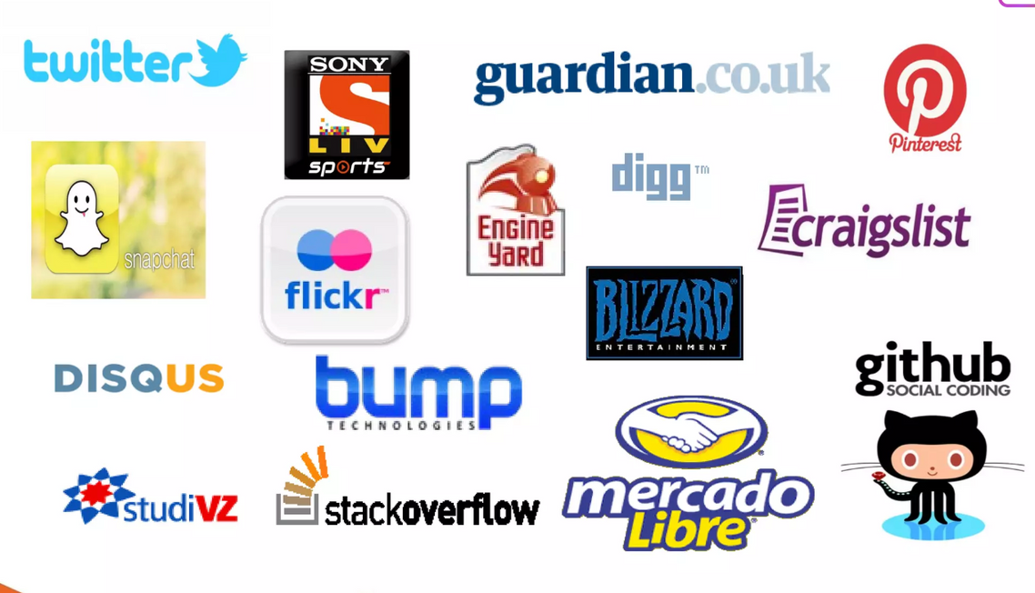




Companies That Uses Redis
GitHub – Background jobs & caching
Twitter – Real-time tweets & timelines
Pinterest – Analytics & session storage
Snapchat – Ephemeral data & caching
Stack Overflow – Caching queries & sessions
Spotify – Recommendations & pub/sub
Instagram – Notifications & session storage
Alibaba – High-speed caching for e-commerce
🔐 Note: 👉 Why? Redis is fast, scalable, and supports a wide range of versatile use cases, including caching, messaging, and real-time data processing.

Slide 24

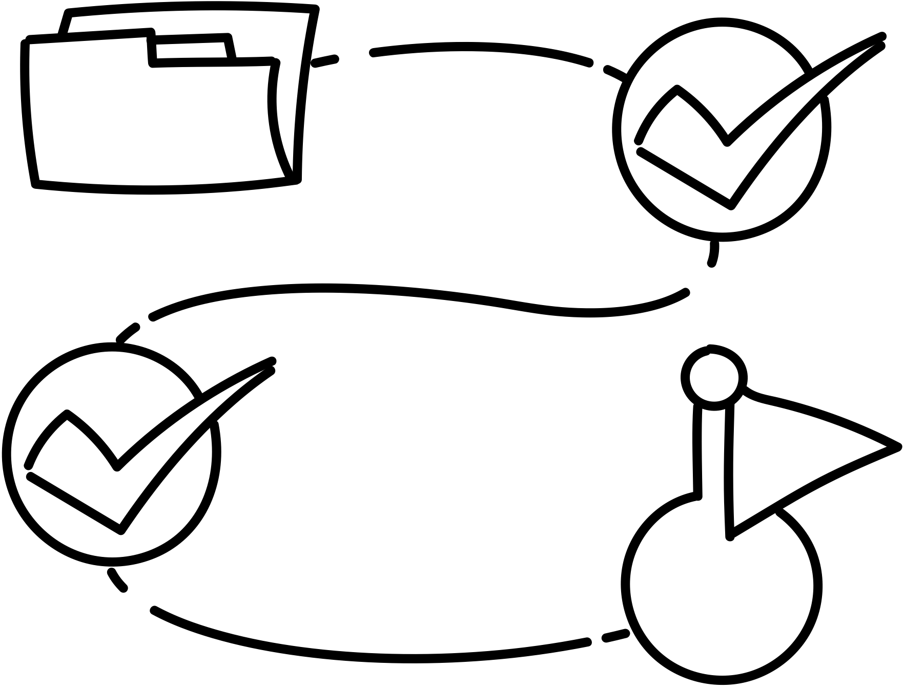
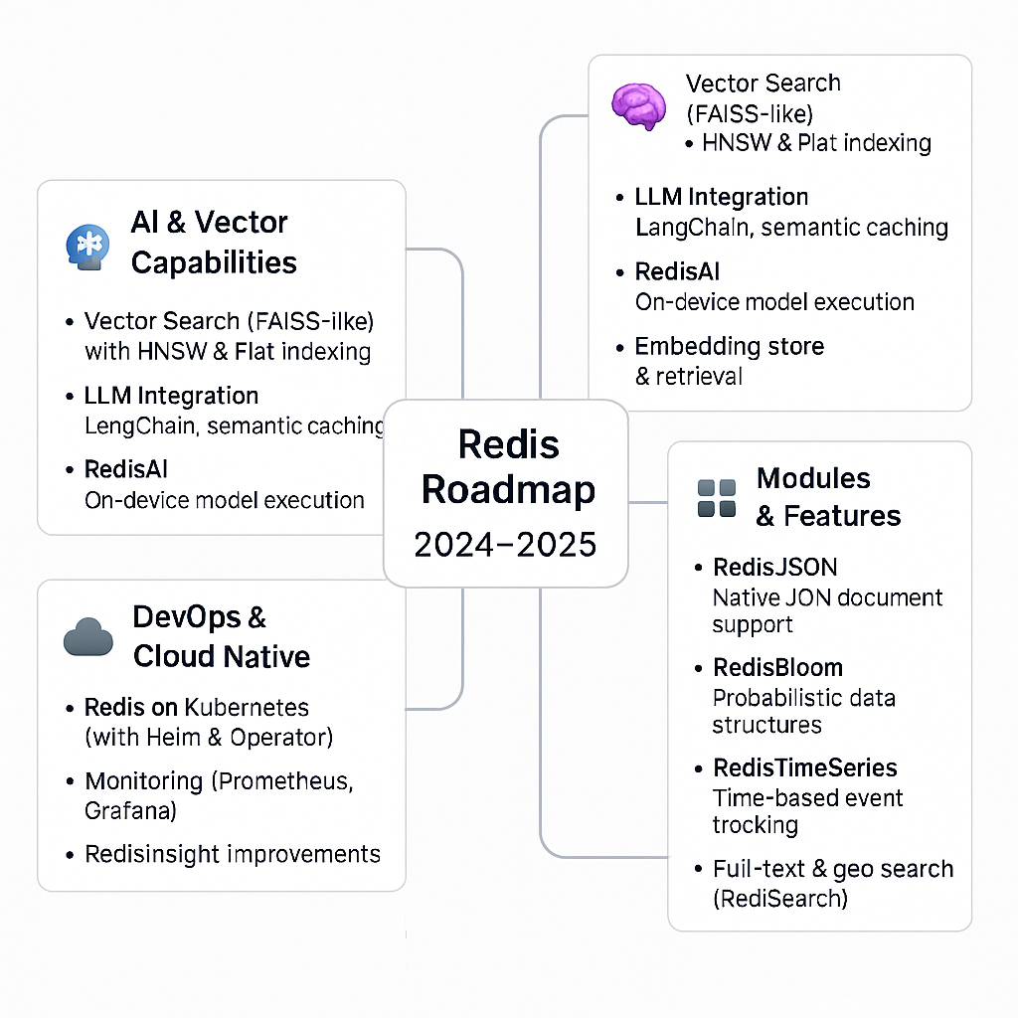
Conclusion & Roadmap
Redis is ideal for high-speed, flexible data access. Whether for caching, messaging, or analytics, Redis is a go-to solution.
Future Trends:
More cloud-native Redis deployments
Expansion of Redis modules (AI, ML, search)
Improved multi-threading support
Redis continues to evolve, offering more ways to handle modern data needs with unmatched performance.

Slide 25

Resources
(where I have created or obtained information from)
Resources
📝 Official Redis Documentation
🔗 Redis.io
Redis Security Best Practices
🔗 Redis security text
Redis Roadmap
🔗 Redis Roadmap
Redis Resources
🔗 Redis Resources
Own Notes & Diagrams
🛠️ Created by Shivam Narendra Vikhar
📁 Based on personal research, assignments, and hands-on experience.

Slide 26
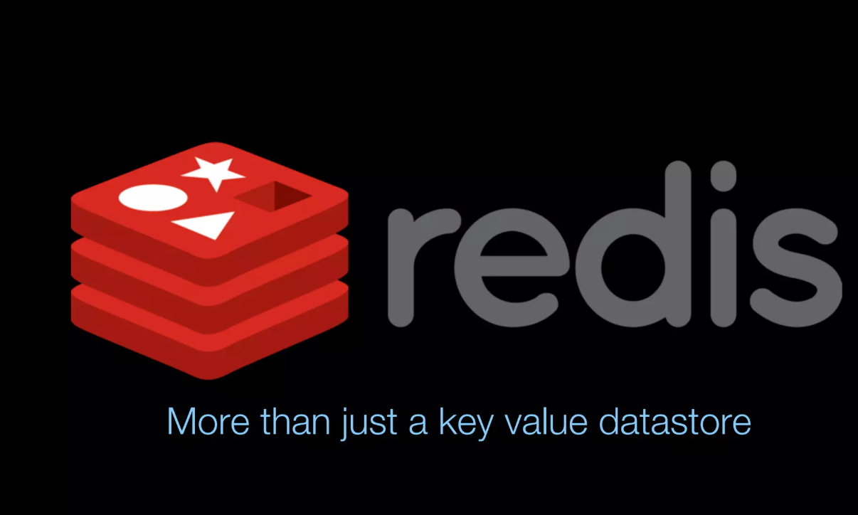
I designed Redis not to be a cache or a database, but a data structure server.
— Salvatore Sanfilippo,
(Creator of Redis)

